Slide 1
Music Player Hasnat Amir 210752 Faizan Abid 120415 Nouman Imran 215192 BSCS-7-A

Slide 2
Introduction:
Using the concepts of data structure and algorithms, and a modern C++ framework we developed a basic music player application.

Slide 3
Problem Statement
No such practice was made in our course time to use our concepts in user defined data types. And a music player is a best example to practice our concepts in data structure and algorithms on practical scale.

Slide 4
Solution
Using concept of doubly and singly linked list and sorting algorithms and with some help of Qt creator framework we are able to create this music application.

Slide 5
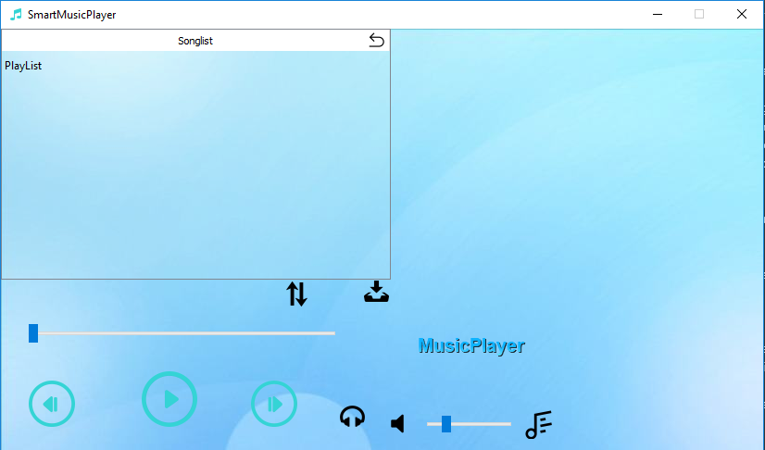
Important results
Starting window

Slide 6
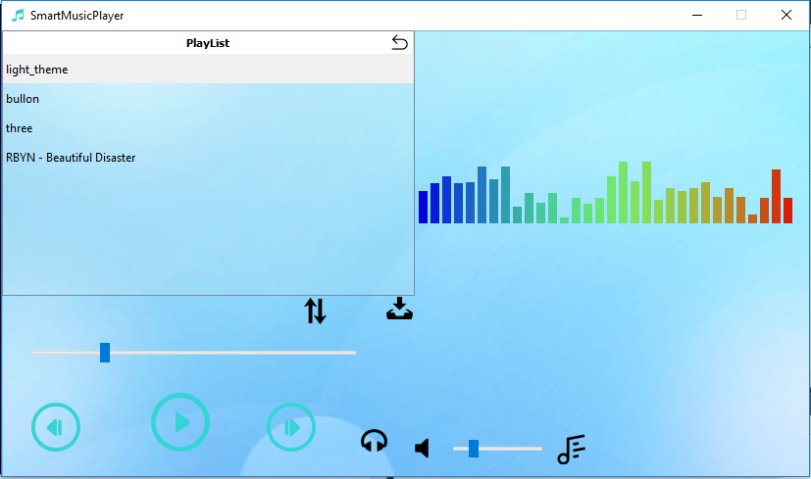
Playlist window with a song being played

Slide 7
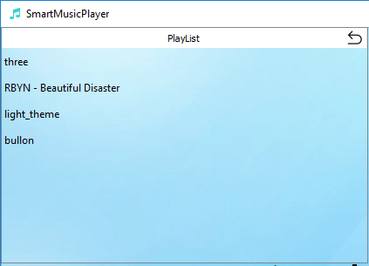
Sorted songs according to names in descending order

Slide 8
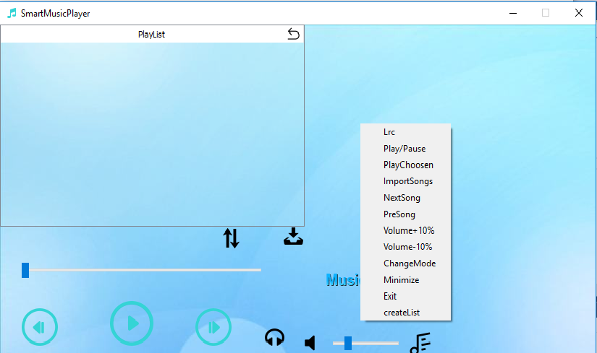
Music player menu sub-window

Slide 9
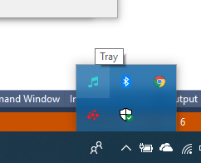
System tray

